Slide 1
4- Applications of GANs for Image Generation
Risman Adnan Mattotorang
Software R&D Director
Samsung R&D Institute Indonesia

Slide 2
Welcome to Data Science Center UI
What You Will Learn Today
GANs Applications for Vision
GANs Applications for NLP
GANs Application for Speech
Reproduction of Some Models
What You Will Practice Today
Realistic Image Generation
Image to Image Translation
Password Cracking
Text to Speech

Slide 3
Outline
Conditional Sequence Generation
Unsupervised Conditional Sequence Generation

Slide 4
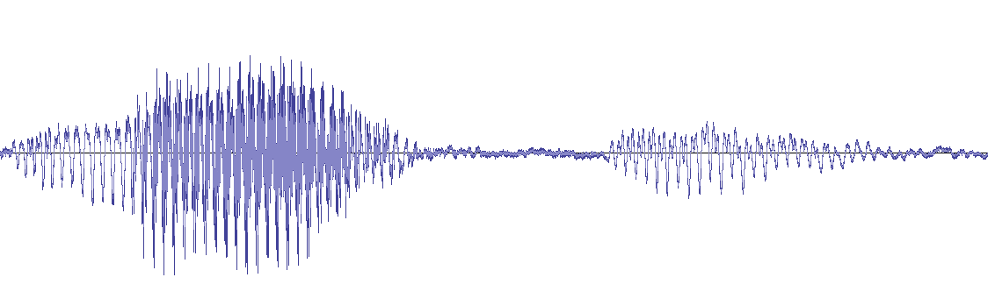
Conditional Sequence Generation
How are you
Machine Learning
I am fine.
Generator
Generator
Generator
機 器 學 習
How are you?
ASR
Translation
Chatbot
The generator is a typical seq2seq model.
With GAN, you can train seq2seq model in another way.
Notes:
Sequence to sequence learning: Both input and output are both sequences with different lengths.

Slide 5
Review: Sequence-to-sequence
Maximize likelihood
Chat-bot as example
I’m good.
Output:
Not bad
I’m John.
Human
better
output sentence x
Training Criterion
better
Training data:
Encoder
Decoder
……
A: How are you ?
B: I’m good.
Seq2seq
Input sentence c
……
How are you ?

Slide 6


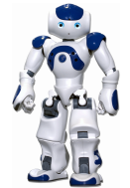


Introduction
Machine obtains feedback from user
Chat-bot learns to maximize the expected reward
How are you?
Hello
Bye bye ☺
Hi ☺
-10
3
Notes:
Consider that you have a non-differentiable objective function
This is cost!
Ignore multiple turns here

Slide 7
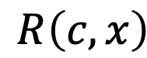
Maximizing Expected Reward
Learn to maximize expected reward
Policy Gradient
Input sentence c
En
De
response sentence x
Chatbot
Input sentence c
Human
$$R\left(c,x\right)$$
response sentence x
reward
[Li, et al., EMNLP, 2016]
Notes:
I am not going to derive the formulation
I will directly give you the results.

Slide 8
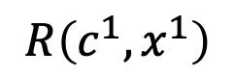
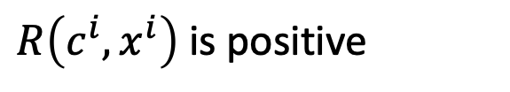
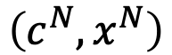
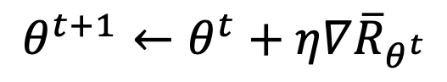

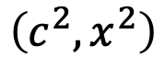
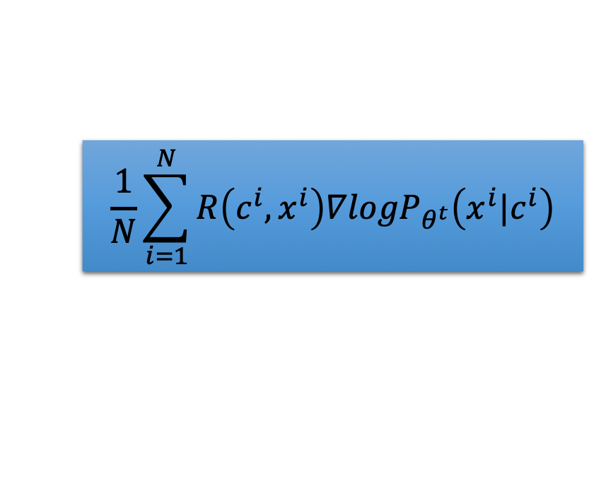
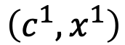
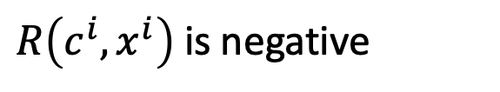
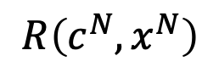
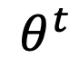
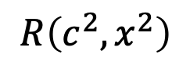

Policy Gradient - Implementation
$$θ^{t+1}←θ^{t}+η∇{\overline{R}}_{θ^{t}}$$
$$θ^{t}$$
$$\frac{1}{N}\sum_{i=1}^{N}{R\left(c^{i},x^{i}\right){∇logP}_{θ^{t}}\left(x^{i}|c^{i}\right)}$$
$$\left(c^{1},x^{1}\right)$$
$$R\left(c^{1},x^{1}\right)$$
$R\left(c^{i},x^{i}\right)$ is positive
$$\left(c^{2},x^{2}\right)$$
$$R\left(c^{2},x^{2}\right)$$
Updating $θ$ to increase $P_{θ}\left(x^{i}|c^{i}\right)$
……
……
$R\left(c^{i},x^{i}\right)$ is negative
$$\left(c^{N},x^{N}\right)$$
$$R\left(c^{N},x^{N}\right)$$
Updating $θ$ to decrease $P_{θ}\left(x^{i}|c^{i}\right)$

Slide 9
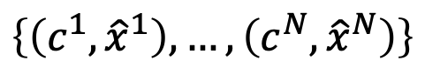
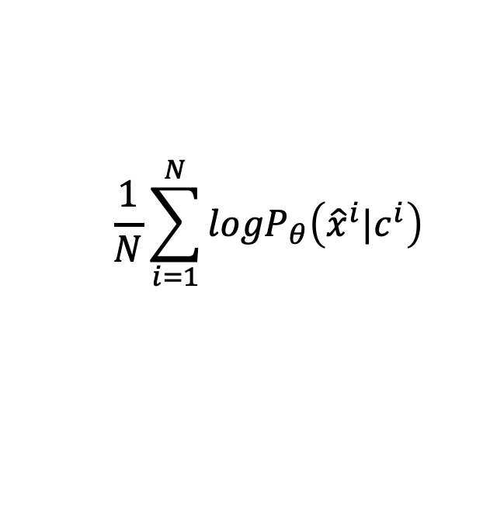
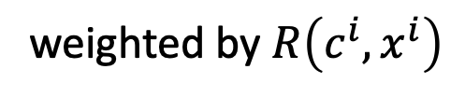
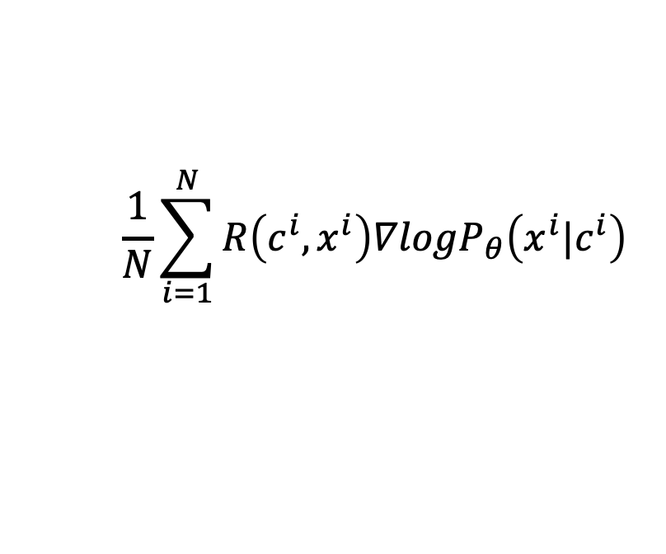
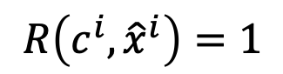
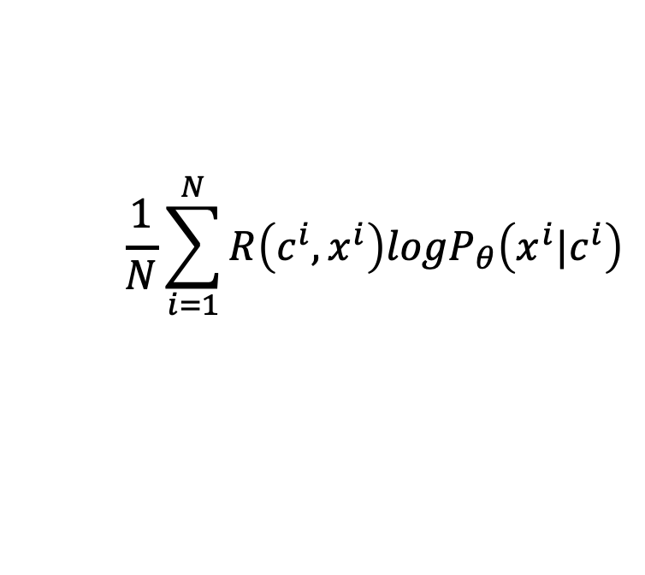
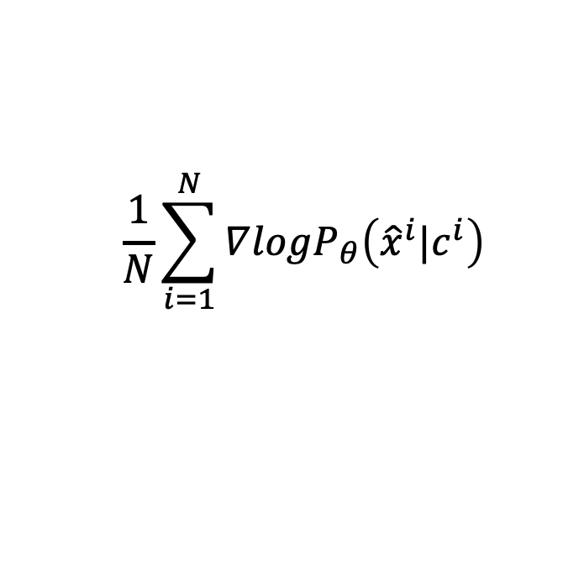
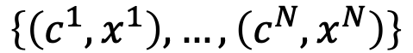
Comparison
Maximum Likelihood
Reinforcement Learning
$$\frac{1}{N}\sum_{i=1}^{N}{{logP}_{θ}\left({\hat{x}}^{i}|c^{i}\right)}$$
$$\frac{1}{N}\sum_{i=1}^{N}{R\left(c^{i},x^{i}\right){logP}_{θ}\left(x^{i}|c^{i}\right)}$$
Objective
Function
$$\frac{1}{N}\sum_{i=1}^{N}{∇{logP}_{θ}\left({\hat{x}}^{i}|c^{i}\right)}$$
$$\frac{1}{N}\sum_{i=1}^{N}{R\left(c^{i},x^{i}\right){∇logP}_{θ}\left(x^{i}|c^{i}\right)}$$
Gradient
Training
Data
$$\left\{\left(c^{1},{\hat{x}}^{1}\right),…,\left(c^{N},{\hat{x}}^{N}\right)\right\}$$
$$\left\{\left(c^{1},x^{1}\right),…,\left(c^{N},x^{N}\right)\right\}$$
$$R\left(c^{i},{\hat{x}}^{i}\right)=1$$
obtained from interaction
weighted by $R\left(c^{i},x^{i}\right)$

Slide 10
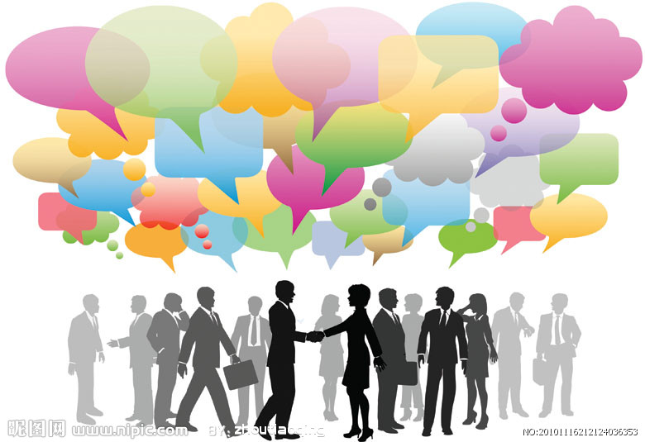
Conditional GAN
Input sentence c
En
De
response sentence x
Chatbot
Input sentence c
Discriminator
Real or fake
response sentence x
“reward”
human
dialogues
[Li, et al., EMNLP, 2017]

Slide 11

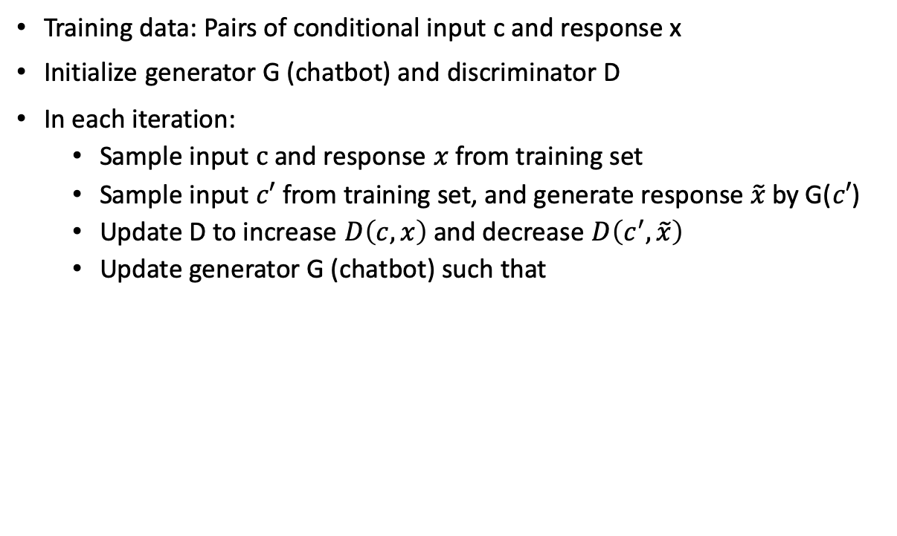
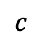
Algorithm
Training data: Pairs of conditional input c and response x
Initialize generator G (chatbot) and discriminator D
In each iteration:
Sample input $c$ and response $x$ from training set
Sample input $c′$ from training set, and generate response $\tilde{x}$ by G($c′$)
Update D to increase $D\left(c,x\right)$ and decrease $D\left(c^{′},\tilde{x}\right)$
Update generator G (chatbot) such that
En
De
Discriminator
$$c$$
scalar
Chatbot
update

Slide 12
En
De
Discriminator
scalar
scalar
Chatbot
update
Discriminator
Can we use gradient ascent?
B
A
A
NO!
A
A
A
B
B
B
Update Parameters
Due to the sampling process, “discriminator+ generator” is not differentiable
<BOS>
A
B
Notes:
(it does not use RNN)

Slide 13
Outline
Conditional Sequence Generation
Unsupervised Conditional Sequence Generation

Slide 14
En
De
Discriminator
scalar
scalar
Chatbot
update
Discriminator
Use the distribution as the input of discriminator
B
A
A
Avoid the sampling process
A
A
A
B
B
B
Update Parameters
We can do backpropagation now.
<BOS>
A
B
Notes:
(it does not use RNN)

Slide 15
What is the problem?
Real sentence
Generated
1
0
0
0
0
0
1
0
0
0
0
0
1
0
0
0
0
0
1
0
0
0
0
0
1
Discriminator can immediately find the difference.
0.9
0.1
0
0
0
0.1
0.9
0
0
0
0.1
0.1
0.7
0.1
0
0
0
0.1
0.8
0.1
0
0
0
0.1
0.9
Can never be 1-of-N
WGAN is helpful

Slide 16
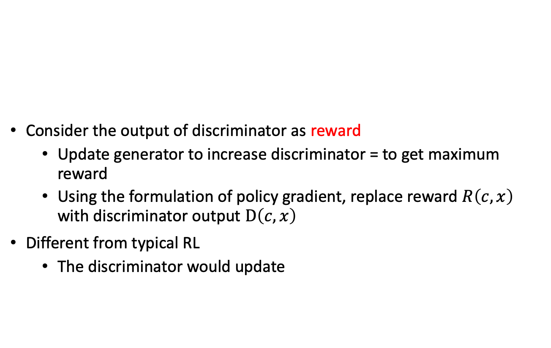
Reinforcement Learning?
Consider the output of discriminator as reward
Update generator to increase discriminator = to get maximum reward
Using the formulation of policy gradient, replace reward $R\left(c,x\right)$ with discriminator output $D\left(c,x\right)$
Different from typical RL
The discriminator would update
En
De
Discriminator
scalar
Chatbot
update
Notes:
The score of current utterances being human-generated ones assigned by the discriminator is used as a reward for generator, which is trained to maximize the expected reward of generated utterances using REINFORCE algorithm.
Actor critic

Slide 17
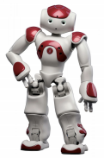
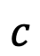
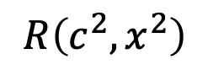

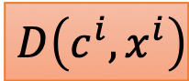
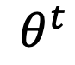

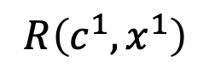
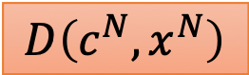
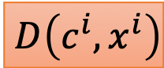
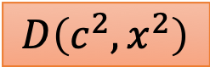
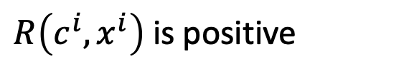
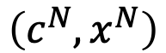
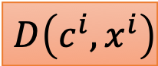
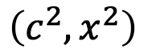
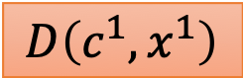

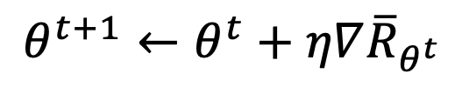
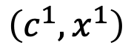
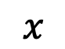
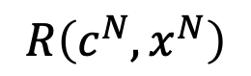
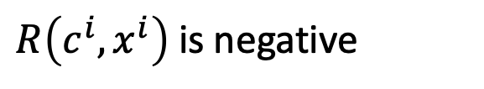
d-step
discriminator
$$x$$
$$c$$
fake
real
g-step
D
$$θ^{t+1}←θ^{t}+η∇{\overline{R}}_{θ^{t}}$$
$$θ^{t}$$
$$\frac{1}{N}\sum_{i=1}^{N}{R\left(c^{i},x^{i}\right){∇logP}_{θ^{t}}\left(x^{i}|c^{i}\right)}$$
$$D\left(c^{i},x^{i}\right)$$
$$D\left(c^{1},x^{1}\right)$$
$$\left(c^{1},x^{1}\right)$$
$$R\left(c^{1},x^{1}\right)$$
$R\left(c^{i},x^{i}\right)$ is positive
$$D\left(c^{i},x^{i}\right)$$
$$D\left(c^{2},x^{2}\right)$$
$$\left(c^{2},x^{2}\right)$$
$$R\left(c^{2},x^{2}\right)$$
Updating $θ$ to increase $P_{θ}\left(x^{i}|c^{i}\right)$
……
……
$$D\left(c^{i},x^{i}\right)$$
$R\left(c^{i},x^{i}\right)$ is negative
$$D\left(c^{N},x^{N}\right)$$
$$\left(c^{N},x^{N}\right)$$
$$R\left(c^{N},x^{N}\right)$$
Updating $θ$ to decrease $P_{θ}\left(x^{i}|c^{i}\right)$

Slide 18
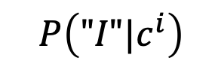
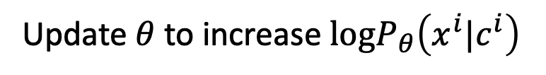
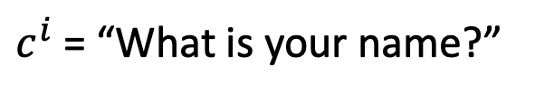
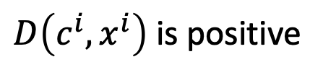
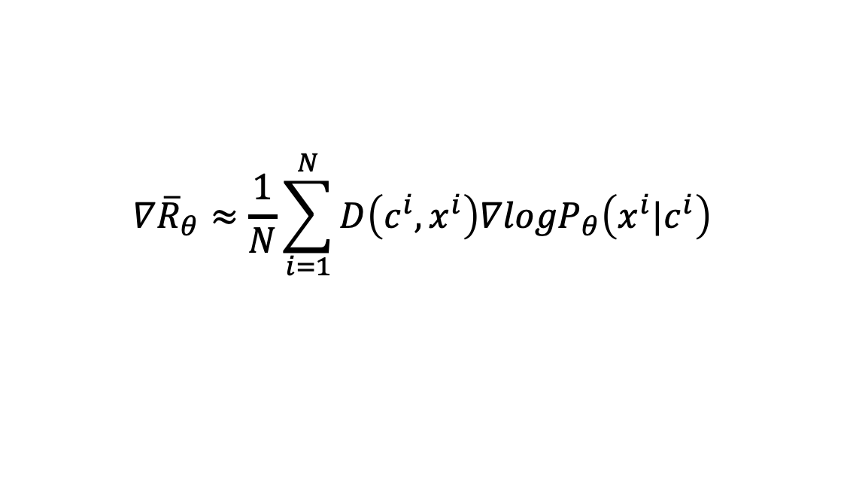






Reward for Every Generation Step
$$∇{\overline{R}}_{θ}≈\frac{1}{N}\sum_{i=1}^{N}{D\left(c^{i},x^{i}\right){∇logP}_{θ}\left(x^{i}|c^{i}\right)}$$
$c^{i}$ = “What is your name?”
$D\left(c^{i},x^{i}\right)$ is negative
$x^{i}$ = “I don’t know”
Update $θ$ to decrease $logP_{θ}\left(x^{i}|c^{i}\right)$
$logP_{θ}\left(x^{i}|c^{i}\right)=logP\left(x_{1}^{i}|c^{i}\right)+logP\left(x_{2}^{i}|c^{i},x_{1}^{i}\right)+$ $logP\left(x_{3}^{i}|c^{i},x_{1:2}^{i}\right)$
$$P\left("I"|c^{i}\right)$$
$c^{i}$ = “What is your name?”
$D\left(c^{i},x^{i}\right)$ is positive
$x^{i}$ = “I am John”
Update $θ$ to increase $logP_{θ}\left(x^{i}|c^{i}\right)$
$logP_{θ}\left(x^{i}|c^{i}\right)=logP\left(x_{1}^{i}|c^{i}\right)+logP\left(x_{2}^{i}|c^{i},x_{1}^{i}\right)+$ $logP\left(x_{3}^{i}|c^{i},x_{1:2}^{i}\right)$
$$P\left("I"|c^{i}\right)$$

Slide 19







Reward for Every Generation Step
$h^{i}$ = “What is your name?”
$x^{i}$ = “I don’t know”
$logP_{θ}\left(x^{i}|h^{i}\right)=logP\left(x_{1}^{i}|c^{i}\right)+logP\left(x_{2}^{i}|c^{i},x_{1}^{i}\right)+$ $logP\left(x_{3}^{i}|c^{i},x_{1:2}^{i}\right)$
$$P\left("I"|c^{i}\right)$$
$$P\left("don′t"|c^{i},"I"\right)$$
$$P\left("know"|c^{i},"I don′t"\right)$$
$$∇{\overline{R}}_{θ}≈\frac{1}{N}\sum_{i=1}^{N}{D\left(c^{i},x^{i}\right){∇logP}_{θ}\left(x^{i}|c^{i}\right)}$$
$$∇{\overline{R}}_{θ}≈\frac{1}{N}\sum_{i=1}^{N}{\sum_{t=1}^{T}{\left(Q\left(c^{i},x_{1:t}^{i}\right)−b\right){∇logP}_{θ}\left(x_{t}^{i}|c^{i},x_{1:t−1}^{i}\right)}}$$
Method 1. Monte Carlo (MC) Search
[Yu, et al., AAAI, 2017]
Method 2. Discriminator For Partially Decoded Sequences
[Li, et al., EMNLP, 2017]
Method 3. Step-wise evaluation
[Tual, et al., arXiv, 2018][Xu, et al., EMNLP, 2018][William Fedus, et al., ICLR, 2018]

Slide 20
Empirical Performance
MLE frequently generates “I’m sorry”, “I don’t know”, etc. (corresponding to fuzzy images?)
GAN generates longer and more complex responses.
Find more comparison in the survey papers. ‘
[Lu, et al., arXiv, 2018][Zhu, et al., arXiv, 2018]
However, no strong evidence shows that GANs are better than MLE.
[Stanislau Semeniuta, et al., arXiv, 2018] [Guy Tevet, et al., arXiv, 2018] [Massimo Caccia, et al., arXiv, 2018]

Slide 21
More Applications
Supervised machine translation [Wu, et al., arXiv 2017][Yang, et al., arXiv 2017]
Supervised abstractive summarization [Liu, et al., AAAI 2018]
Image/video caption generation [Rakshith Shetty, et al., ICCV 2017][Liang, et al., arXiv 2017]
Speech Recognition [Liu, et al., arXiv 2018]
If you are using seq2seq models,
consider to improve them by GAN.
Notes:
IRGAN: A Minimax Game for Unifying Generative and Discriminative Information Retrieval Models
Improving Neural Machine Translation with Conditional Sequence Generative Adversarial Nets，

Slide 22
















Part 1
male
female
Part 2
positive sentences
negative sentences
document
summary
Unsupervised Abstractive Summarization
Text Style Transfer
Language 1
Language 2
Audio
Text
Unsupervised Translation
Unsupervised ASR

Slide 23









Direct Transformation
as close as possible
$$G_{X→Y}$$
$$G_{Y→X}$$
scalar: belongs to domain X or not
$$D_{Y}$$
scalar: belongs to domain Y or not
$$D_{X}$$
$$G_{Y→X}$$
$$G_{X→Y}$$
as close as possible

Slide 24
Direct Transformation
as close as possible
$$G_{X→Y}$$
$$G_{Y→X}$$
It is bad.
It is good.
It is bad.
negative
positive
negative
$$D_{Y}$$
$$D_{X}$$
positive sentence?
negative sentence?
I love you.
$$G_{Y→X}$$
$$G_{X→Y}$$
I hate you.
I love you.
positive
negative
positive
as close as possible

Slide 25
Direct Transformation
Discrete?
Word embedding
[Lee, et al., ICASSP, 2018]
as close as possible
$$G_{X→Y}$$
$$G_{Y→X}$$
It is bad.
It is good.
It is bad.
negative
positive
negative
$$D_{Y}$$
$$D_{X}$$
positive sentence?
negative sentence?
I love you.
$$G_{Y→X}$$
$$G_{X→Y}$$
I hate you.
I love you.
positive
negative
positive
as close as possible

Slide 26


感謝 王耀賢 同學提供實驗結果
Cycle GAN
Negative sentence to positive sentence: it's a crappy day -> it's a great day i wish you could be here -> you could be here it's not a good idea -> it's good idea i miss you -> i love you i don't love you -> i love you i can't do that -> i can do that i feel so sad -> i happy it's a bad day -> it's a good day it's a dummy day -> it's a great day sorry for doing such a horrible thing -> thanks for doing a great thing my doggy is sick -> my doggy is my doggy my little doggy is sick -> my little doggy is my little doggy
[Lee, et al., ICASSP, 2018]

Slide 27
感謝 張瓊之 同學提供實驗結果
Cycle GAN
Negative sentence to positive sentence:
胃疼 , 沒睡醒 , 各種不舒服 -> 生日快樂 , 睡醒 , 超級舒服
我都想去上班了, 真夠賤的! -> 我都想去睡了, 真帥的 !
暈死了, 吃燒烤、竟然遇到個變態狂 -> 哈哈好 ~ , 吃燒烤 ~ 竟然遇到帥狂
蕭哥, 我肚子痛的厲害 -> 蕭哥, 我生日快樂厲害
感冒了, 難受的說不出話來了 ! -> 感冒了, 開心的說不出話 來 !

Slide 28








Projection to Common Space
Decoder hidden layer as discriminator input
[Shen, et al., NIPS, 2017]
Discriminator of X domain
Positive
Sentence
$${EN}_{X}$$
$${DE}_{X}$$
Positive
Sentence
$$D_{X}$$
Negative
Sentence
$${EN}_{Y}$$
$${DE}_{Y}$$
Negative
Sentence
$$D_{Y}$$
Discriminator of Y domain
${EN}_{X}$ and ${EN}_{Y}$ fool the domain discriminator
Domain
Discriminator
From ${EN}_{X}$ or ${EN}_{Y}$
[Zhao, et al., arXiv, 2017]
[Fu, et al., AAAI, 2018]

Slide 29
Part 1
male
female
Part 2
positive sentences
negative sentences
document
summary
Unsupervised Abstractive Summarization
Text Style Transfer
Language 1
Language 2
Audio
Text
Unsupervised Translation
Unsupervised ASR

Slide 30





Abstractive Summarization
Now machine can do abstractive summary by seq2seq (write summaries in its own words)
summary 1
summary 2
summary
(in its own words)
summary 3
seq2seq
Supervised: We need lots of labelled training data.
Training Data
Notes:
Title generation: abstractive summary with one sentence

Slide 31
Unsupervised Abstractive Summarization
Now machine can do abstractive summary by seq2seq (write summaries in its own words)
summary 1
summary 2
summary 3
seq2seq
document
Domain X
[Wang, et al., EMNLP, 2018]
Domain Y
Notes:
Title generation: abstractive summary with one sentence

Slide 32
Unsupervised Abstractive Summarization
Human written summaries
Real or not
D
Discriminator
word
sequence
document
Summary?
G
Seq2seq

Slide 33
Unsupervised Abstractive Summarization
Human written summaries
Real or not
D
Discriminator
word
sequence
document
document
G
R
Seq2seq
Seq2seq
minimize the reconstruction error

Slide 34

Unsupervised Abstractive Summarization
Only need a lot of documents to train the model
This is a seq2seq2seq auto-encoder.
Using a sequence of words as latent representation.
not readable …
word
sequence
document
document
G
R
Summary?
Seq2seq
Seq2seq

Slide 35
Unsupervised Abstractive Summarization
REINFORCE algorithm to deal with the discrete issue
Human written summaries
Real or not
Let Discriminator considers my output as real
D
Discriminator
word
sequence
document
document
Readable
G
R
Summary?
Seq2seq
Seq2seq

Slide 36
Experimental results
English Gigaword (Document title as summary)
 | ROUGE-1 | ROUGE-2 | ROUGE-L
Supervised | 33.2 | 14.2 | 30.5
Trivial | 21.9 | 7.7 | 20.5
Unsupervised (matched data) | 28.1 | 10.0 | 25.4
Unsupervised (no matched data) | 27.2 | 9.1 | 24.1
Matched data: using the title of English Gigaword to train Discriminator
No matched data: using the title of CNN/Diary Mail to train Discriminator
Notes:
Reinforcement learning was used to deal with the non-differentiable issue.

Slide 37
Semi-supervised Learning
Using matched data
semi-supervised
unsupervised
Approaches to deal with the discrete issue.
3.8M pairs are used.

Slide 38
Unsupervised Abstractive Summarization
感謝 王耀賢 同學提供實驗結果
Document:澳大利亞今天與13個國家簽署了反興奮劑雙邊協議,旨在加強體育競賽之外的藥品檢查並共享研究成果 ……
Summary:
Human:澳大利亞與13國簽署反興奮劑協議
Unsupervised:澳大利亞加強體育競賽之外的藥品檢查
Document:中華民國奧林匹克委員會今天接到一九九二年冬季奧運會邀請函,由於主席張豐緒目前正在中南美洲進行友好訪問,因此尚未決定是否派隊赴賽 ……
Summary:
Human:一九九二年冬季奧運會函邀我參加
Unsupervised:奧委會接獲冬季奧運會邀請函

Slide 39
Unsupervised Abstractive Summarization
感謝 王耀賢 同學提供實驗結果
Document:據此間媒體27日報道,印度尼西亞蘇門答臘島的兩個省近日來連降暴雨,洪水泛濫導致塌方,到26日為止至少已有60人喪生,100多人失蹤 ……
Summary:
Human:印尼水災造成60人死亡
Unsupervised:印尼門洪水泛濫導致塌雨
Document:安徽省合肥市最近為領導幹部下基層做了新規定:一律輕車簡從,不準搞迎來送往、不準搞層層陪同 ……
Summary:
Human:合肥規定領導幹部下基層活動從簡
Unsupervised:合肥領導幹部下基層做搞迎來送往規定:一律簡

Slide 40
Part 1
male
female
Part 2
positive sentences
negative sentences
document
summary
Unsupervised Abstractive Summarization
Text Style Transfer
Language 1
Language 2
Audio
Text
Unsupervised Translation
Unsupervised ASR

Slide 41


[Alexis Conneau, et al., ICLR, 2018]
[Guillaume Lample, et al., ICLR, 2018]
supervised
unsupervised
Unsupervised learning with 10M sentences
$$=$$
Supervised learning with 100K sentence pairs
Notes:
de 德文 German
Star War
C-3PO learnt the Ewok language through observation.
https://scifi.stackexchange.com/questions/124394/how-did-c3po-know-the-ewok-language
The 3PO-series protocol droids are equipped with a TranLang III communications module. It comes with up to six million galactic languages - common and obscure, organic and inorganic - at purchase. It also possessed phonetic pattern analysers that provides the capability to learn and translate new languages not in its existing database.
Same corpus or not?
Unsupervised Machine Translation

Slide 42
Part 1
male
female
Part 2
positive sentences
negative sentences
document
summary
Unsupervised Abstractive Summarization
Text Style Transfer
Language 1
Language 2
Audio
Text
Unsupervised Translation
Unsupervised ASR

Slide 43




Acoustic Token Discovery
Acoustic tokens can be discovered from audio collection without text annotation.
Acoustic tokens: chunks of acoustically similar audio segments with token IDs
[Zhang & Glass, ASRU 09]
[Huijbregts, ICASSP 11]
[Chan & Lee, Interspeech 11]

Slide 44
Acoustic Token Discovery
Token 3
Token 2
Token 1
Token 2
Token 3
Token 1
Token 1
Token 4
Token 3
Acoustic tokens can be discovered from audio collection without text annotation.
Acoustic tokens: chunks of acoustically similar audio segments with token IDs
[Zhang & Glass, ASRU 09]
[Huijbregts, ICASSP 11]
[Chan & Lee, Interspeech 11]

Slide 45


Unsupervised Speech Recognition
p₁
p₂
p₃
p₄
AY L AH V Y UW
p₁
p₃
p₂
G UH D B AY
HH AW AA R Y UW
p₁
p₄
p₃
p₅
p₅
GAN
AY M F AY N
p₁
p₅
p₄
p₃
T AY W AA N
Phone-level Acoustic
Pattern Discovery
Phoneme sequences
from Text
[Liu, et al., INTERSPEECH, 2018]
p₁
=
“AY”
[Chen, et al., arXiv, 2018]

Slide 46

Phoneme recognition
[Liu, et al., INTERSPEECH, 2018]
(using oracle phoneme boundaries)
supervised
Audio: TIMIT
Text: WMT
Unsupervised (Gumbel-softmax)
Unsupervised (WGAN-GP)
Word recognition
[Chung, et al., NIPS, 2018]
Audio: Librispeech
Text: SWC
Achieved 23.7% accuracy
Notes:
I admit50.84

Slide 47
Welcome to Data Science Center UI
What You Will Learn Today
GANs Applications for Vision
GANs Applications for NLP
GANs Application for Speech
Reproduction of Some Models
What You Will Practice Today
Realistic Image Generation
Image to Image Translation
Password Cracking
Text to Speech

